Slide 1


Slide 2


Slide 3


Slide 4


Slide 5

Rockbuster Video Business Analysis
Esteban Torres-Flores

Slide 6

Summary of Statistics
Average Film Length - 115 minutes
Number of Customers - 599 customers
Average Rental Duration - 5 days
Number of Titles - 1000 titles
Average Rental Price - $2.98
Total Inventory - 4581 films
Average Replacement Cost - $19.98
Number of Rentals- 16,044 rentals
*Most films in the Rockbuster library are rated PG-13

Slide 7
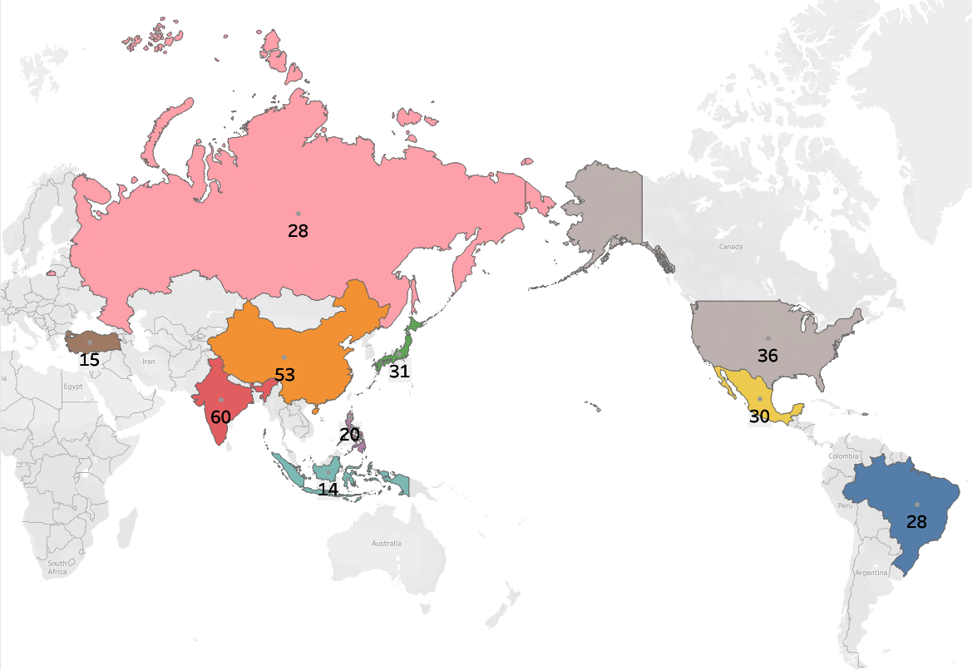
Descriptive Analysis
Top 10 Countries by Customer Count
Rockbuster has customers in many countries. In these map visualizations we can view the Top 10 countries with the most customers.

Slide 8
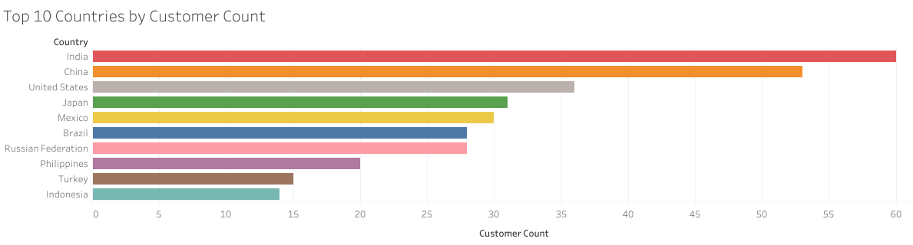
This horizontal bar chart of Ruckbusters top 10 countries by customer count shows a clear picture of the countries with the highest customers. In the next slide we will compare it to the rental count and revenue to establish a correlation. We most likely will see that these 10 countries are the majority drivers of revenue.

Slide 9
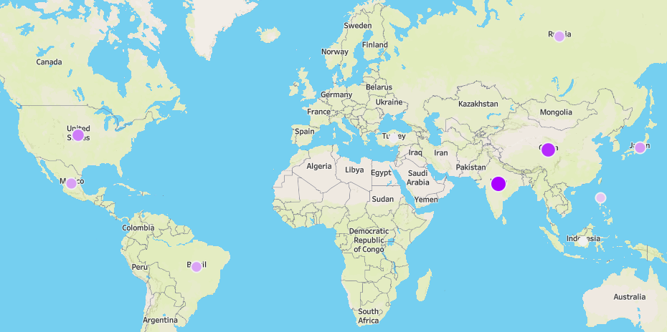
Top 10 Countries rental Revenue Bubble Chart
This bubble chart visually compares the top 10 countries by total revenue, helping to quickly identify which markets are high-performing overall.

Slide 10
Rental Revenue Summary
Country | Rental Count | Revenue | % of Revenue
India | 1422 | 6032.79 | 9.84
China | 1297 | 5247.04 | 8.56
United States | 869 | 3694.27 | 6.03
Japan | 749 | 3121.52 | 5.09
Mexico | 718 | 2984.82 | 4.87
Brazil | 681 | 2919.19 | 4.76
Russian Federation | 638 | 2765.62 | 4.51
Philippines | 530 | 2219.70 | 3.62
Turkey | 351 | 1498.49 | 2.44
Indonesia | 331 | 1352.69 | 2.21
Top 10 Countries by rental, revenue, and % of company revenue
This table illustrates the top 10 countries by the number of rentals and the revenue they bring in. It is important to know that the order of countries by rental and revenue is the same order as by customer count. This indicates a strong correlation between the number of customers and the number of rentals and revenue.

Slide 11
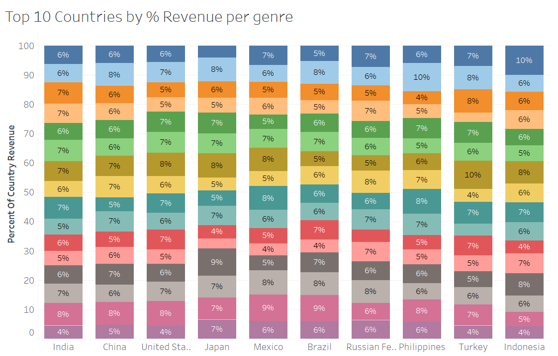
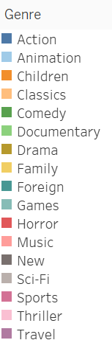
Top 10 Countries % Revenue by Genre
For the most part there seems to be a distribution of revenue throughout the different genres. Thriller being the exception being highly underrepresented.

Slide 12
Preferred Genre of each of the top 10 Countries
Country | Preferred Genre
India | Sports
China | Animation
United States | Sports
Japan | Drama
Mexico | Sports
Brazil | Sports
Russian Federation | Animation
Philippines | Sci-Fi
Turkey | Drama
Indonesia | Action
From the top 10 countries the favorite genre are sports, animation, and action. But individually they each have their differences. We can clearly see sports as a clear winner from this table. To truly know the top three genres, it's best to look at the top 10 together as opposed to the individual countries.

Slide 13
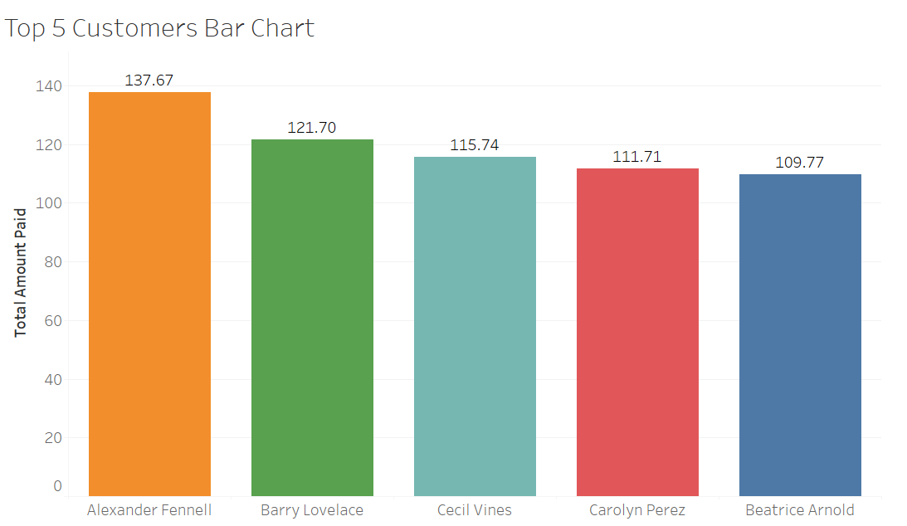
High Value Customers
Comparative Analysis
Customer Name | City, Country | Total Amount Spent
Alexander Fennell | Bergamo, Italy | $136.67
Barry, Lovelace | Kitwe, Zambia | $121.70
Cecil Vines | London, United Kingdom | $115.74
Carolyn Perez | Pak Kret, Thailand | $111.71
Beatrice Arnold | Udaipur, India | $109.77

Slide 14
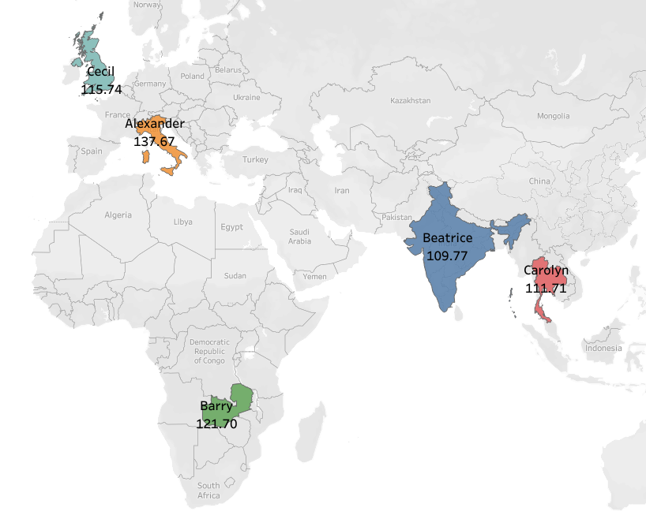
Top 5 Customers Spatial Analysis
When we look at the top 5 customers, we can see that they are not necessarily in the top 10 countries. This is surprising! This is good insight as it might indicate a potential source for revenue that Rockbuster might be missing out on. Is it an anomaly or is there a demand in those countries that Rockbuster is not capitalizing on?

Slide 15
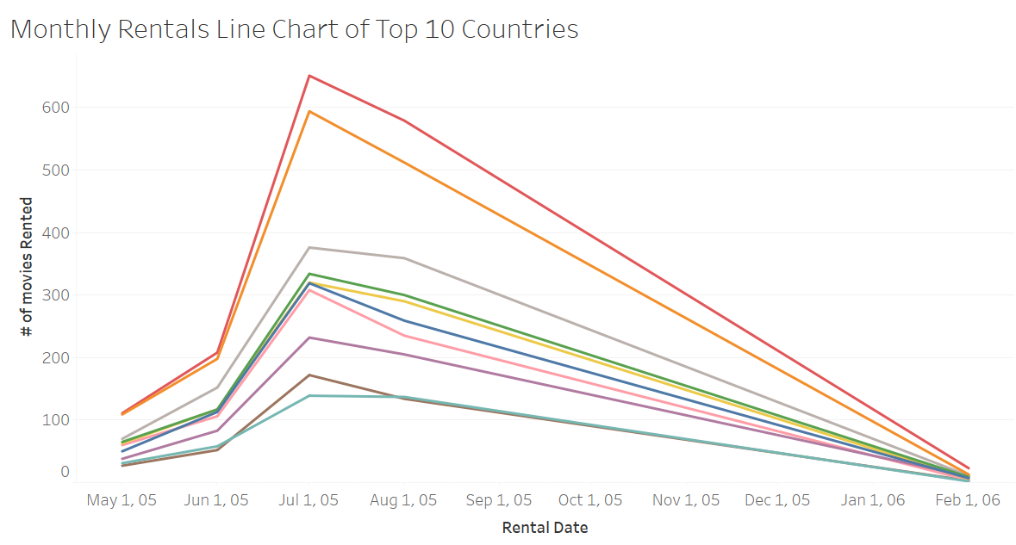
Seasonal Trend
The seasonal trend indicates increased sales during the summer months of the year. Good insight to have when preparing any marketing campaigns, new rental releases, or promotions.

Slide 16
Business Summary
To understand where Ruckbuster strongest markets are financially, I analyzed the total revenue contribution of the top 10 countries. Out of those 10 countries, India, China, and the United States are the three countries that contribute the most to Rockbusters revenue. All three of them total to almost 25% of the company's revenue.
There are emerging markets that appear to be exceeding expectations. Notably, Italy, Zambia, the United Kingdom, and Thailand are home to 4 of our top 5 customers, yet these countries are not among the top 10 by total revenue. This suggests these regions may be underperforming at a broader level but have high-value customer potential. This may indicate untapped opportunities for targeted growth and strategic investment.”
No single genre overwhelmingly dominates any market, suggesting a diverse viewer base. This opens the door for offering bundled genre packages or seasonal promotions tailored by region.

Slide 17
Recommendations
The top 10 countries indicate a strong brand presence that can be a guide for future investment support, increase marketing, or potential expansion. These are also the countries driving most of the revenue.
The fact that the top 5 customers are primarily from underrepresented countries, rather than the top 10 by customer count, rentals, or revenue, suggests a potential misalignment. This insight highlights an opportunity for marketing to investigate why these smaller markets are yielding high-value customers and how that success can be scaled.
Seasonal trends indicate a spike in demand during the summer months. With this insight, the company can strategically add more titles and offer exclusive deals to maximize engagement.
Conversely, rental activity tends to dip in the winter, suggesting that targeted promotions or discounts during this period could help boost rentals and maintain steady revenue.

Slide 18
Appendix
Rental Price
Minimum Rental Price - $0.99
Maximum Rental Price - $4.99
Replacement Cost
Minimum Replacement Cost - $9.99
Maximum Replacement Cost - $29.99
Rental Duration
Minimum Rental Duration - 3 days
Maximum Rental Duration - 7 days
Film Length
Minimum Film Length - 46 minutes
Maximum Film Length - 185 minutes
Rating | Count
PG-13 | 223
NC-17 | 210
R | 195
PG | 194
G | 180

Slide 19
Tableau Public Links
https://public.tableau.com/views/RuckbusterAnalysisVisualizations/Top10Map?:language=en-US&:sid=&:redirect=auth&:display_count=n&:origin=viz_share_link

Slide 20


